Slide 1
Logistic Regression

Slide 2
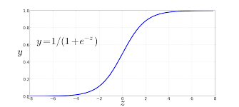
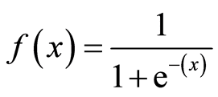
INTRODUCTION
Logistic regression is a classification algorithm. It is used to predict a binary
outcome based on a set of independent variables.
For example,
To predict whether an email is spam (1) or (0)
Whether the tumor is malignant (1) or not (0)
The function for Logistic Regression is sigmoid function

Slide 3
Sigmoid Function
x = independent variable
e = 2.718 , natural logarithm base(also known as Euler’s number).
Sigmoid function trying to convert the independent variable(feature) into a expression of Probability that ranges between 0-1 with respect to dependent variable.

Slide 4
Types of Logistic Regression
Binomial Logistic Regression
Multinomial Logistic Regression
Ordinal Logistic Regression

Slide 5
Binomial Logistic Regression
This used to predict the relationship between the dependent variable (Y) and the independent variable (X), where the dependent variable is binary in nature.
For example, the output can be Success/Failure, 0/1 , True/False, or Yes/No.
Multinomial logistic regression
This is used when you have one categorical dependent variable with two or more unordered levels (i.e two or more discrete outcomes).

Slide 6
Multinomial logistic regression
let’s imagine that you want to predict what will be the most-used transportation type in the year 2030. The transport type will be the dependent variable, with possible outputs of train, bus, tram, and bike (for example).
Ordinal logistic regression
This is used when the dependent variable (Y) is ordered (i.e., ordinal). The dependent variable has a meaningful order and more than two categories or levels.
Examples of scores on a test (Poor/Average/Good).

Slide 7
Application of Logistic Regression
Credit scoring
Text editing
Hotel Booking

Slide 8
Thank You

